Slide 1
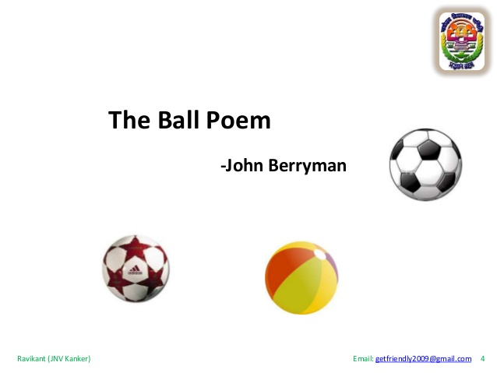
SECTION C:LITERATURE &LONG READING
POEM: THE BALL POEM
BY

Slide 2
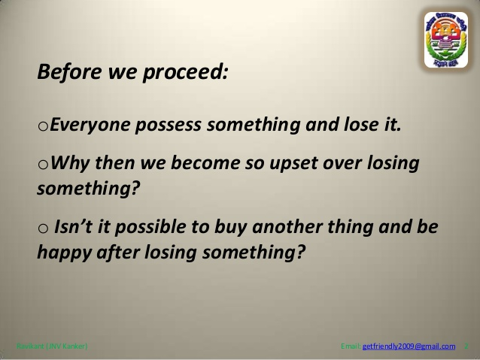

Slide 3
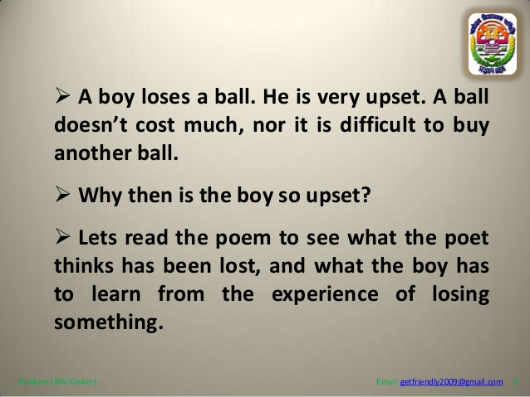
SUMMARY

Slide 4
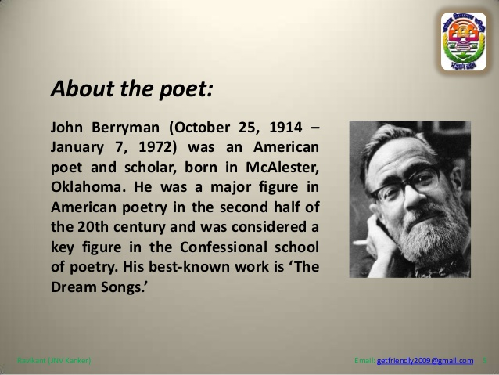

Slide 5
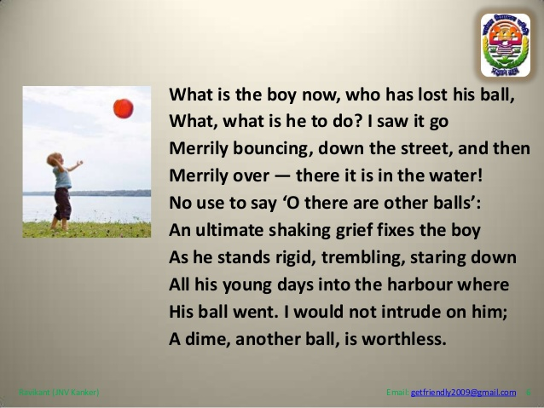
STANZA 1

Slide 6
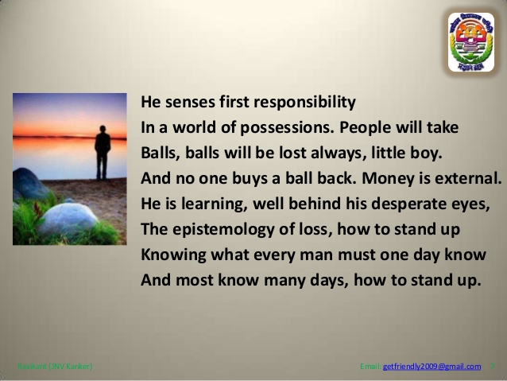
STANZA 2

Slide 7
THEME
Loss of innocence:
For the little boy in this poem, his ball is the first thing he has ever held dear. However, he has never even considered the possibility that he might one day lose his ball. It is only when that happens that he realizes that it was his responsibility to keep the ball safe and that he has failed. The boy quickly realizes that everything he will ever own will be his responsibility. He also realizes that things will get lost from time to time and money simply cannot replace them all. As he is learning these lessons, he is growing up. He will never again be as innocent he was before the loss of his ball. He will never be naive enough to not feel the pressure of his responsibilities. This is a very painful thing for the poet to watch.

Slide 8
THEME
Loss of a loved one:
This poem has a surface meaning as well as a deeper meaning. If we read between the lines, we will see that the ball symbolizes our family or friends whom we love, and the loss of the ball symbolizes their death. As we grow older, we will become more and more accustomed to seeing our loved ones die. We will learn how to deal with such a loss and to move on from it as well. Death may grieve us or cause us to feel depressed, but sooner or later we must overcome those feelings and start living our normal lives again.

Slide 9
The Tone of The Ball Poem:
The tone of this poem is very somber and sad. The way in which the poet describes the boy’s feelings upon losing the ball makes us feel great sympathy for the boy. Even more than that, we can all relate to the experience that the boy is going through. That is perhaps why the poem does not overly depress us. The resignation that the boy feels can also be felt by us since death is not something that any man can escape.

Slide 10
Critical Analysis of The Ball Poem:
This poem can be interpreted both literally and metaphorically. If taken literally, it is a soulful picture of little boys growing up and learning to deal with the loss of the first thing he has ever held dear. If taken metaphorically, it is the story of mankind learning to deal with the loss of their loved ones. The ball is a metaphor for everything that we think is irreplaceable in our lives. It is obvious that anything that is irreplaceable is very valuable to us, and it is our responsibility to take care of those things. People taking away one’s ball or one’s ball getting lost is a metaphor for death. What is most precious to us is a person whom we love dearly.

Slide 11
CONCLUSION
Hence, we always try to take care of them. But sooner or later, every man must die, for man is a mortal creature. There is nothing we can do to stop this process, and hence it is something we must learn to deal with. Loss of a loved one can spell a period of intense grief and depression for some of us. However, just like the little boy is brought back to his senses by the sound of the whistle, we must overcome our grief and keep living. The poet’s message is that life goes on despite the death of our loved ones.

